Slide 1
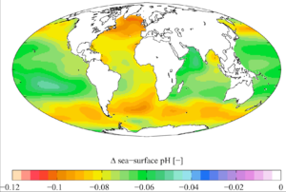
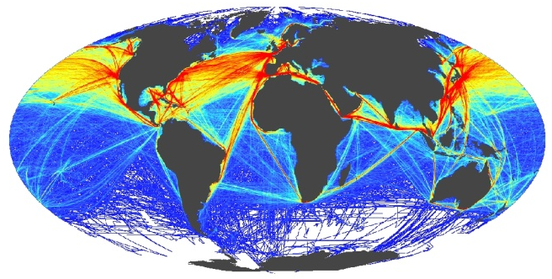

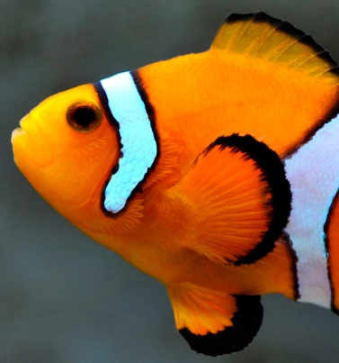
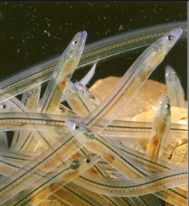
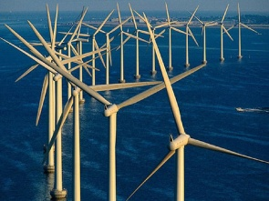
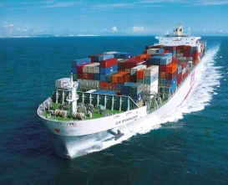


Global environmental change impacts auditory behaviour and survival of larvae
Dr Steve Simpson
School of Biological Sciences
University of Bristol

Slide 2
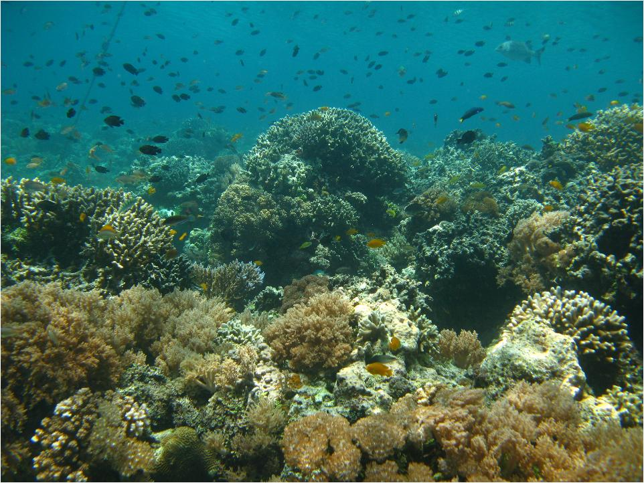
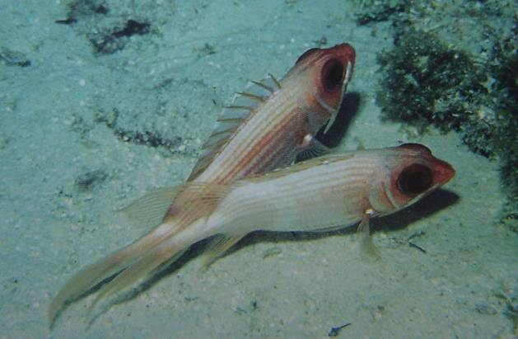

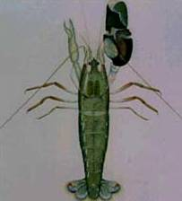
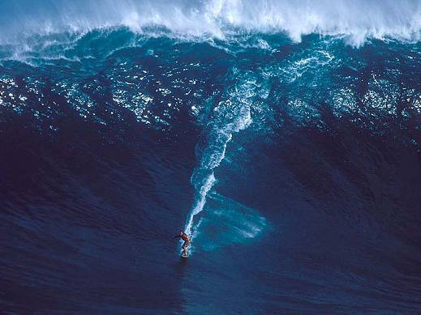
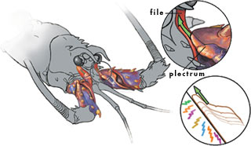
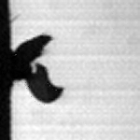
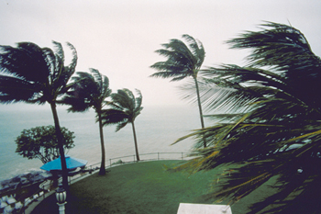
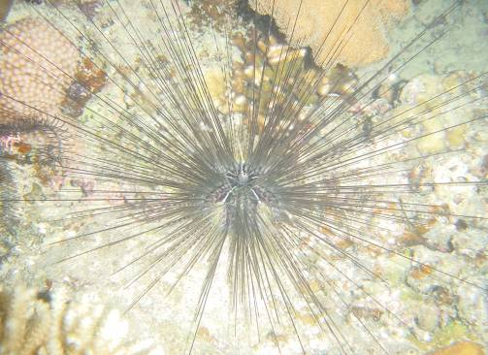
Reefs are noisy places
rain
fish
Versluis et al. 2000 Science
waves
other invertebrates
wind and water sheer

Slide 3
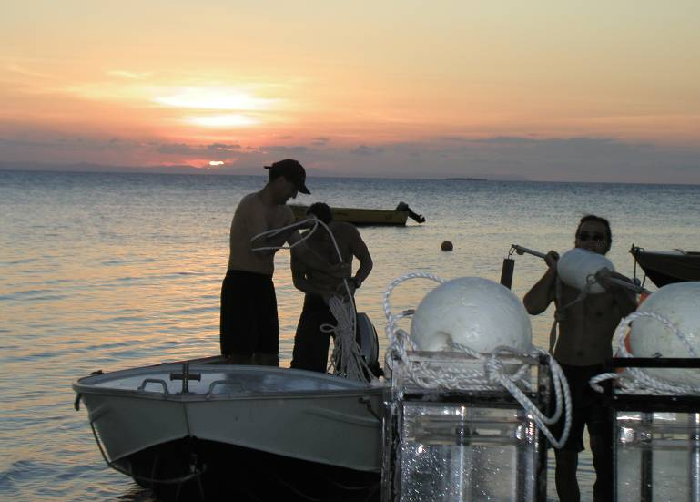
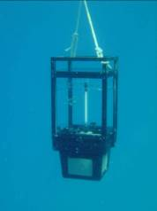
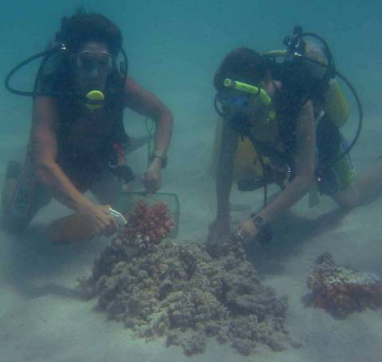
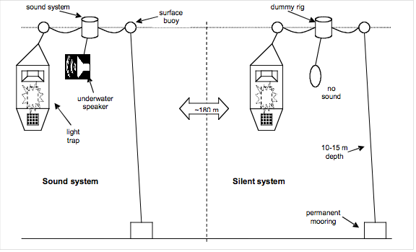
Larval reef fish use reef noise for orientation
Simpson et al. 2004 Mar Ecol Prog Ser
10 families of reef fish attracted by reef noise
Simpson et al. 2008 Animal Behaviour
Settlement-stage fish prefer invertebrate noise
Simpson et al. 2005 Science
Reef fish attracted to settlement sites by reef noise
sound
dummy rig
surface
system
buoy
speaker
dummy
broadcasting
speaker
reef noise
3
-
6 m
depth
patch
>100 m
>100 m
Simpson et al. 2008 Coral Reefs
Adult & juvenile fish prefer fish vocalisations
reefs
permanent
mooring
Notes:
3

Slide 4
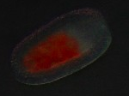
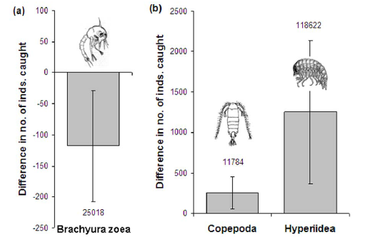
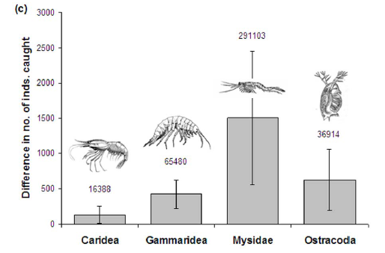
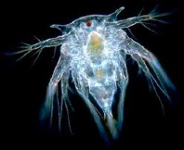
Invertebrates also interact with reef soundscapes
Jenni Stanley, Craig Radford, Andrew Jeffs, John Montgomery
Lobsters use noise for orientation and to induce settlement
Vermeij et al. 2010 PLoS ONE
Coral larvae can detect and orient towards reef noise
Simpson et al. 2011 PLoS ONE
Planktonic crustaceans avoid reef noise (anti-predator response?)
settling larvae
holoplankton
nocturnally emergent taxa
Notes:
4

Slide 5
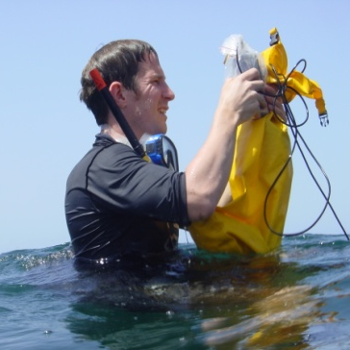
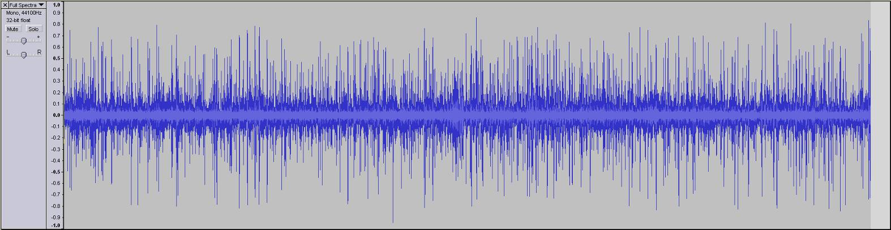
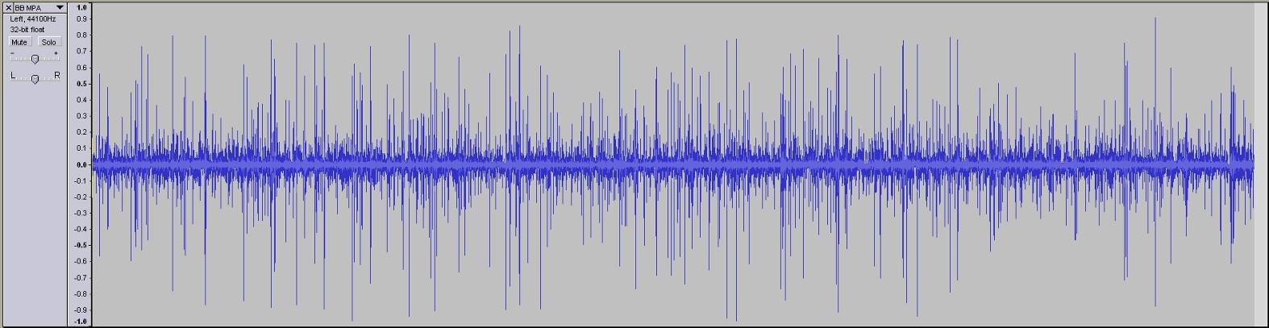
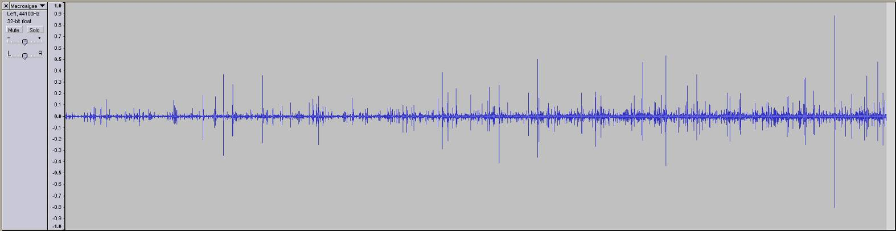
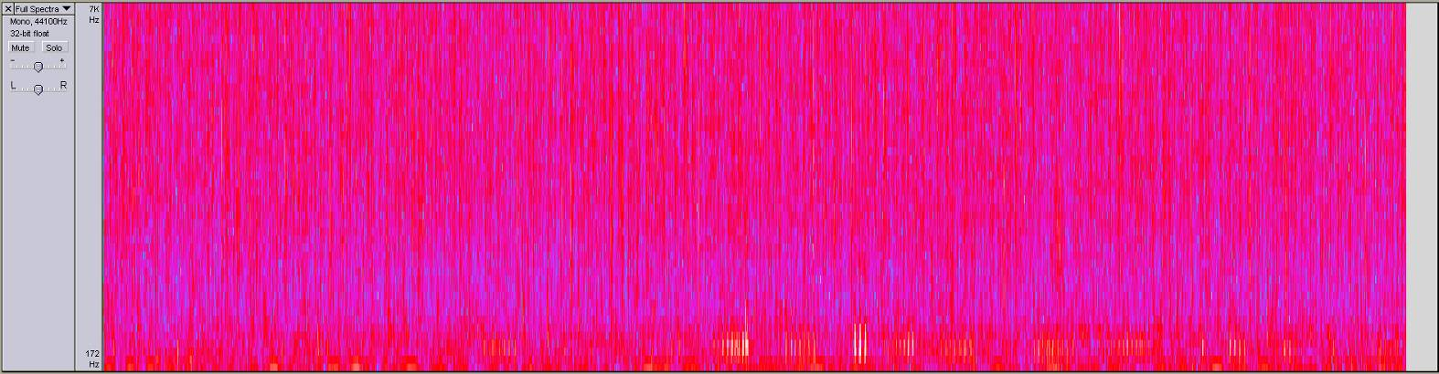
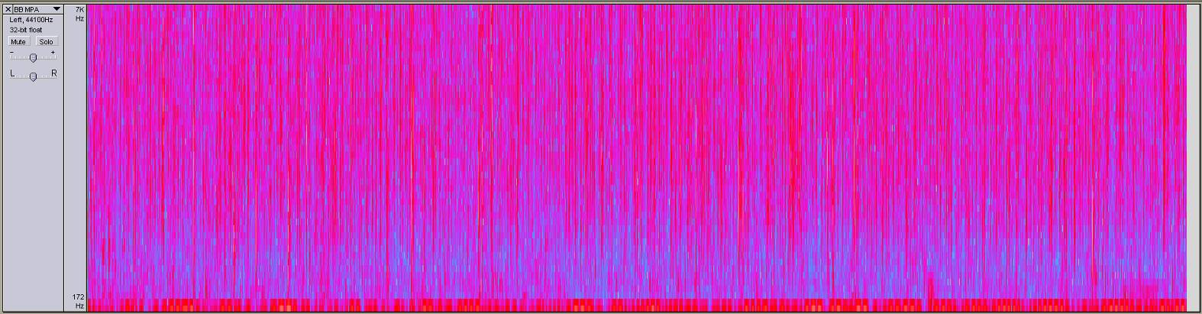
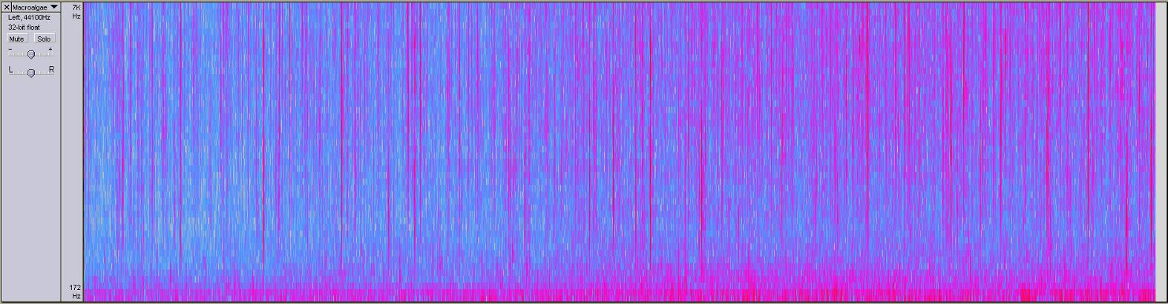
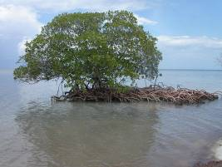
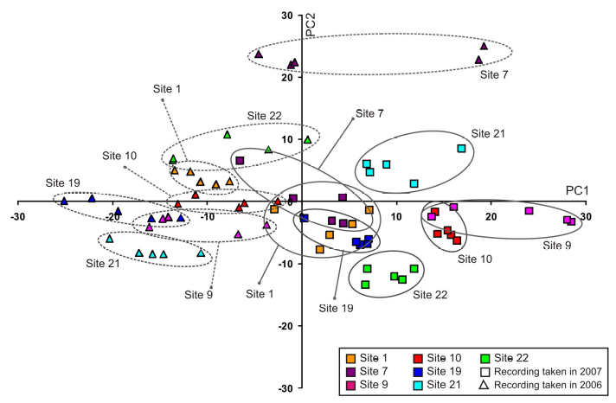
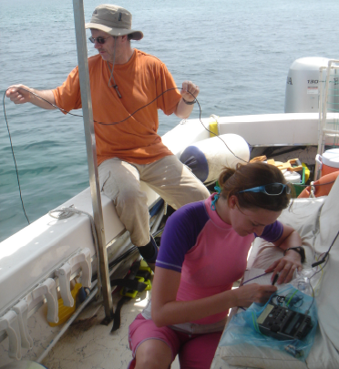
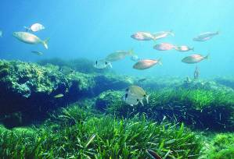
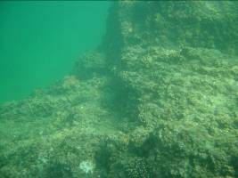
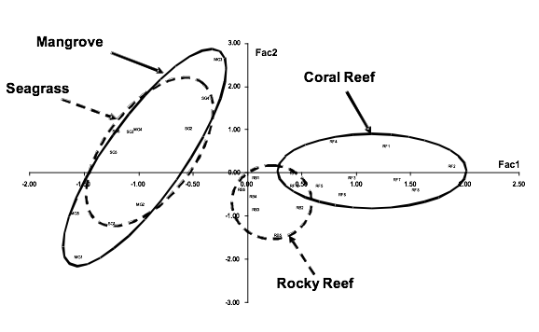
Reef noise indicates habitat characteristics
Simpson 2008 Bioacoustics
- Reef noise as a tool for management?
Kennedy et al. 2010 JEMBE
- Reef noise indicates coral cover and fish densities
Huijbers et al. 2012 Ecology
- Ambient noise differentiates coral, rubble, and mangrove/seagrass habitat
Radford et al. 2011 Coral Reefs & Huijbers et al. 2012 Ecology
- Settling reef fish use noise to select preferred microhabitat (fringing reef, lagoon) and to locate nearby nursery grounds and conspecific shoals
Notes:
Kennedy et al
Huijbers et al
5

Slide 6
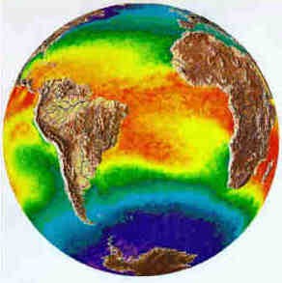


Global environmental change
Warming
Ocean acidification

Slide 7
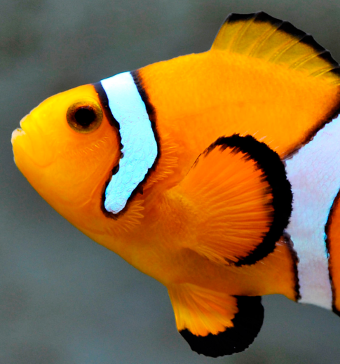
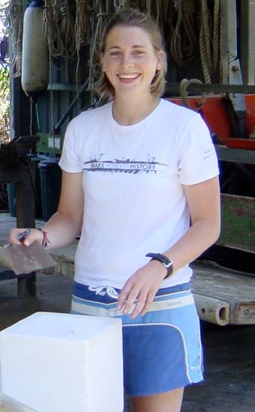
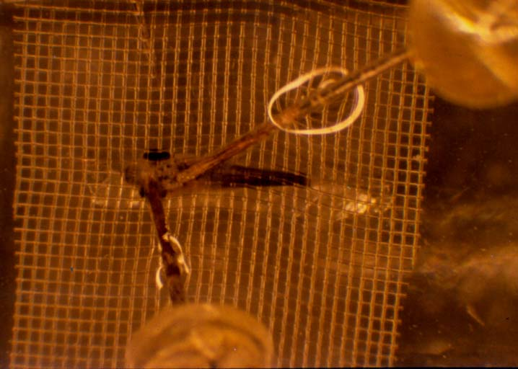
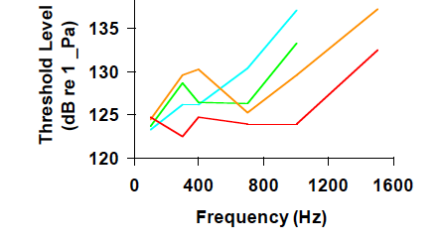
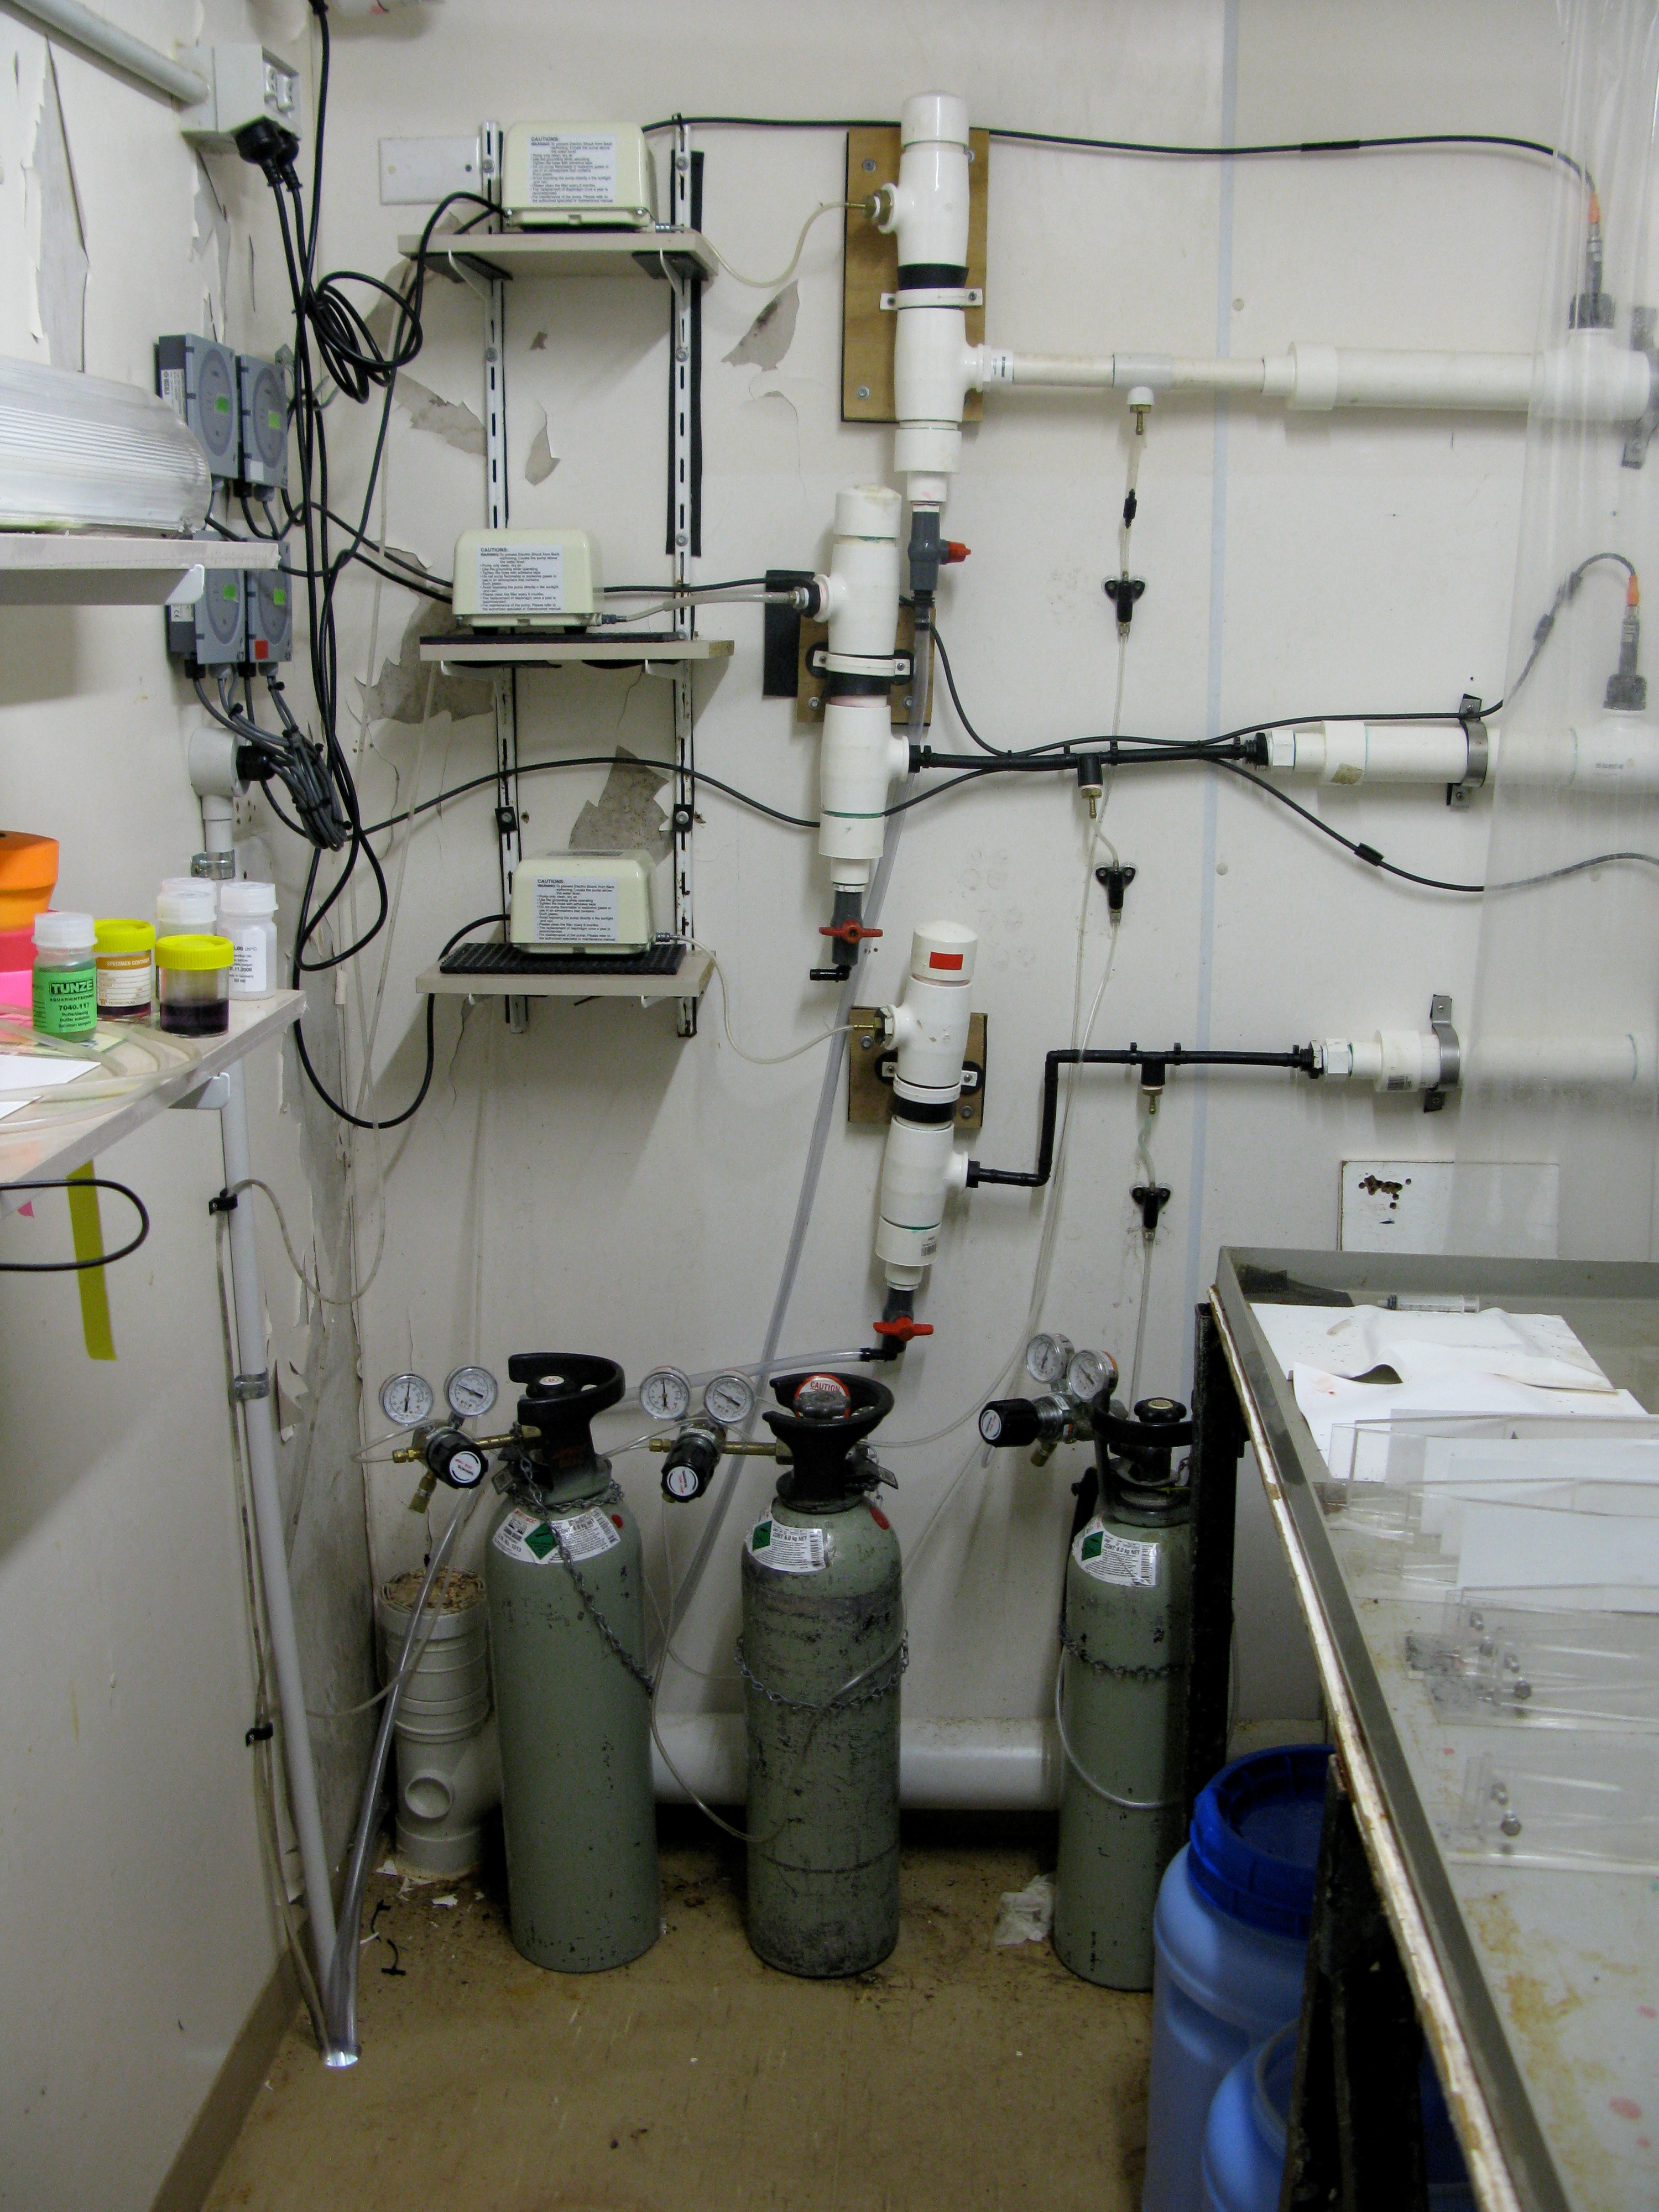
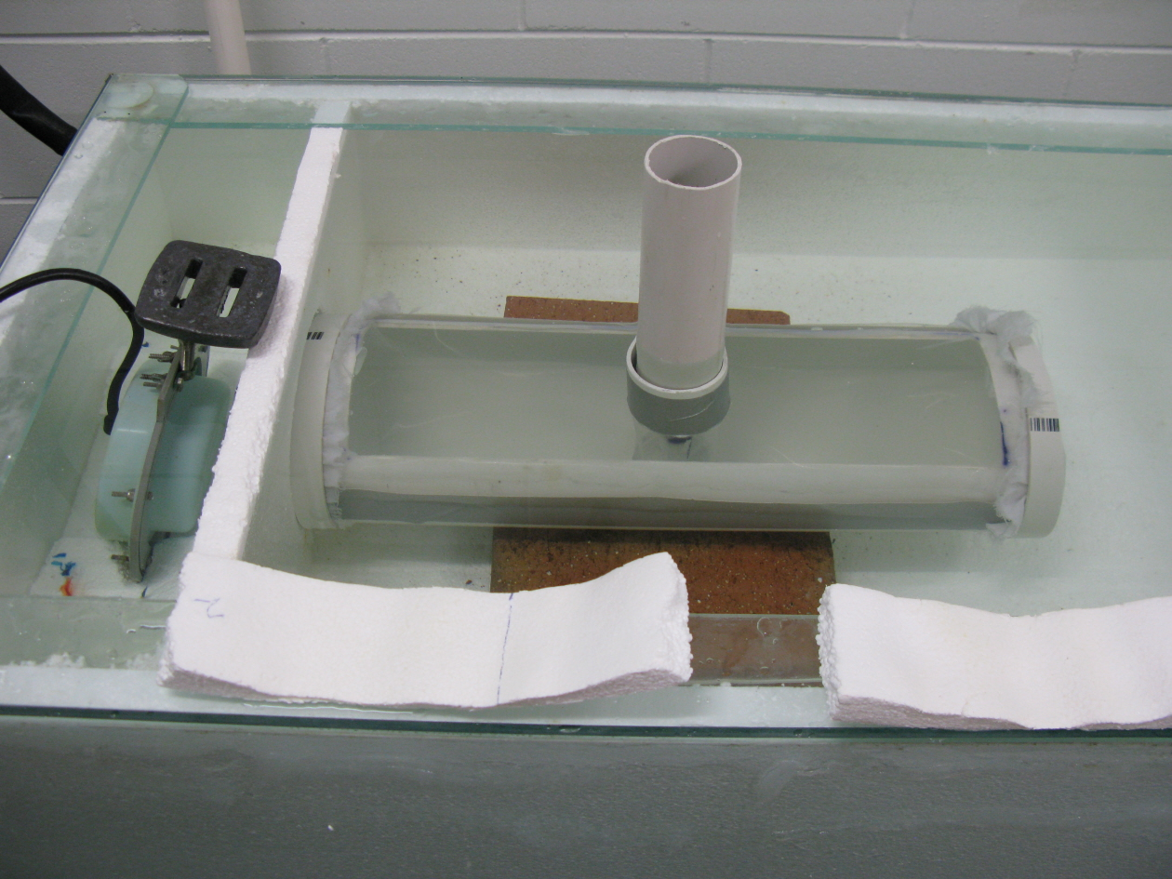
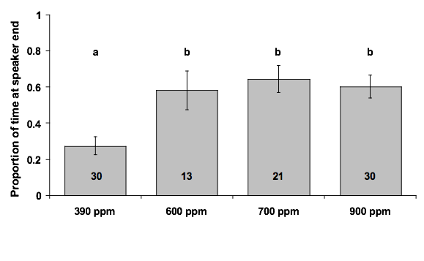
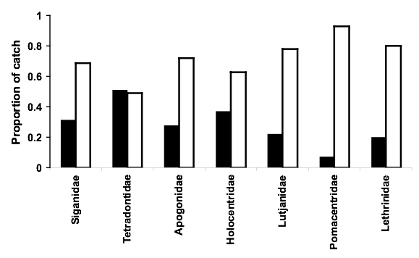
Ocean acidification erodes crucial auditory behaviour
Munday, Dixson, Domenici, Ferrari et al.
CO₂ disrupts olfaction, physiology, cognitive function
Heenan et al. 2009 Proc 10th ICRS
73%
36-42%
Fish reared at current CO₂ levels avoided predator noise
Fish in elevated CO₂ conditions showed no response
Simpson et al. 2005 Mar Ecol Prog Ser
Simpson et al. 2011 Biology Letters
Notes:
7

Slide 8
Global environmental change
Warming
Anthropogenic noise
Ocean acidification

Slide 9
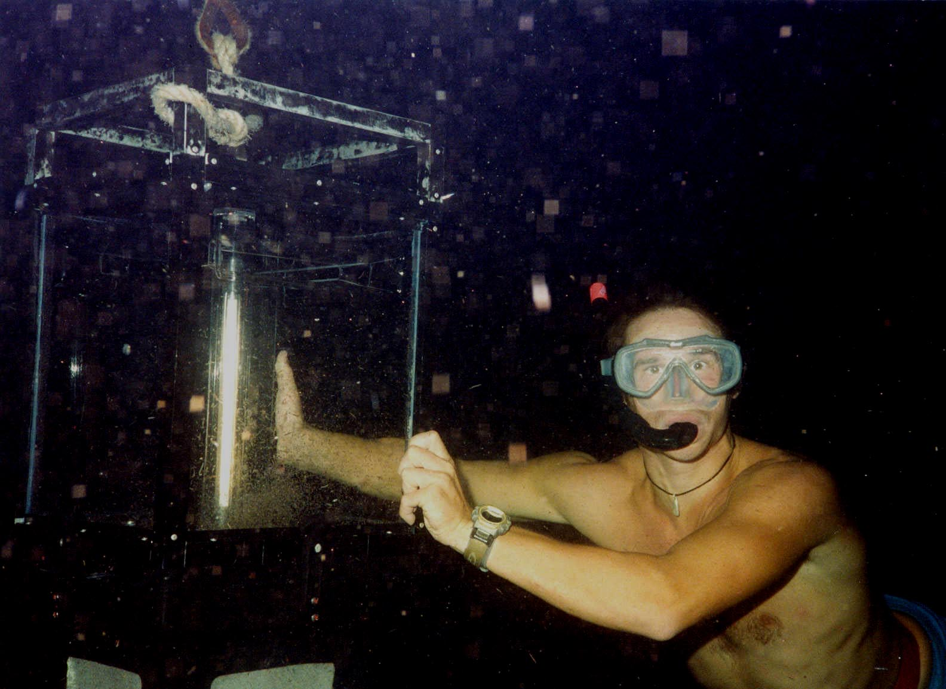
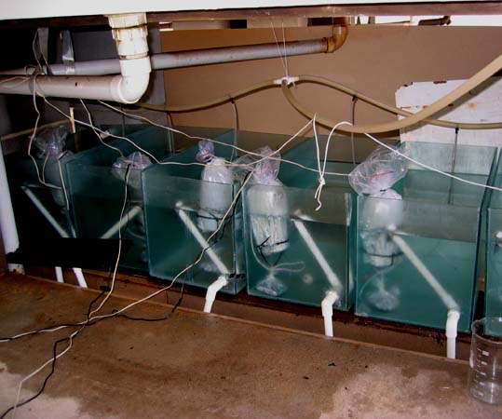
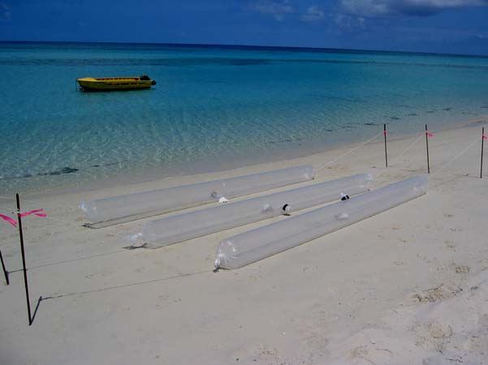
Reef fish larvae conditioned by artificial noise
 |  | Choice chamber test
 |  | Silence | Reef noise | Tone Mix
Noise played in tank during the day | Silence
 | Reef noise
 | Tone Mix
No response
No response
No response
No response
Attracted
Avoided
No response
Attracted
Attracted
Simpson et al. 2010 Behavioral Ecology
Notes:
9

Slide 10

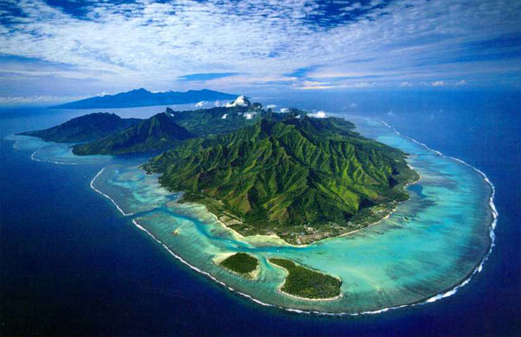
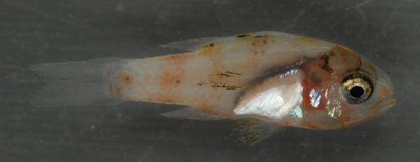

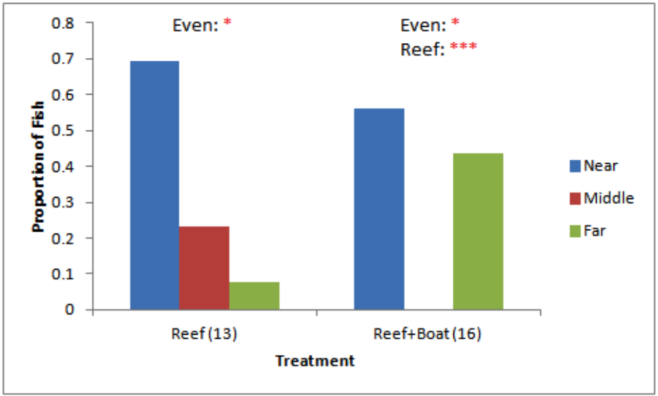

Boat noise affects orientation behaviour
Holles et al. In review.
Boat noise disrupts ability
to resolve 180° ambiguity?
Notes:
10

Slide 11









Anthropogenic noise compromises anti-predator behaviour, physiology and cognition in fish
Steve Simpson, Julia Purser, Andy Radford
Notes:
Third study to present
Anthropogenic noise on increase - many sources - affects cetaceans: communication, strandings
Causes physiological damage to fish at high intensities
Not known what more subtle effects may be
Anti-predator behaviour can be added into population models

Slide 12





Effects of ship noise on anti-predator responses to pursuit and ambush “predators”, and on respiration, metabolism and cognitive functioning
Eels captured twice as quickly
by pursuit predators
Eels avoided ambush predator 75% less often, and with greater latency
Increased opercular beat & metabolic rate indicates stress
Decreased cognitive functioning
Simpson et al. In review.
Notes:
What we found
Blocked design, 3 ships, 3 harbours
Pursuit predator - time to capture after 2 min acclimatisation, track switched to ambient or ship, blind
Ambush predator - looming predator on arm 1st time eel entered zone of danger after track switched
us behind hide, blind to treatment
Ambient: 80% elicited a startle response; Ship: 63% did not
Sig greater lag response time during ship noise
Opercular beat - indicates stress - standard measure in aquaculture/physiology - repeat measure
Metabolic rate - another secondary stress level indicator - describe experiment - impacts on growth?
Lateralisation - used as measure of cognitive functioning - describe experiment - repeat measure

Slide 13











Acknowledgements
Reef noise
Mark Meekan
Andrew Jeffs
Craig Radford
John Montgomery
Rob McCauley
Ivan Nagelkerken
Edd Codling
Dave Smith
David Lecchini
Chantal Huijbers
Adel Heenan
Emma Kennedy
Julius Piercy
Ocean Acidification
Phil Munday
Hong Yan
Matt Wittenrich
Monica Gagliano
Dani Dixson
Rachel Manassa
Ships & eels
Bioacoustics & Behavioural Ecology
Andy Radford
Marc Holderied
Daniel Robert
Rick Bruintjes
Julia Purser
Sophie Holles
Emma Kerridge
Matt Wale

Slide 14
Notes:
14

